Slide 1

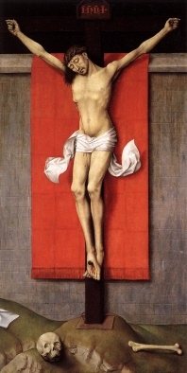
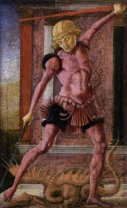
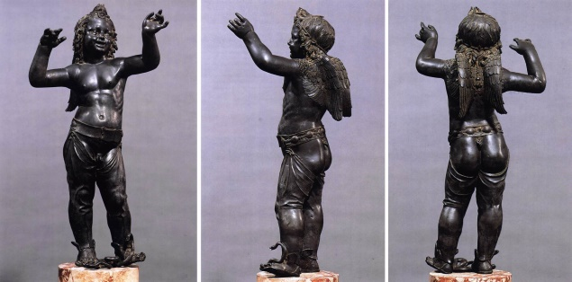
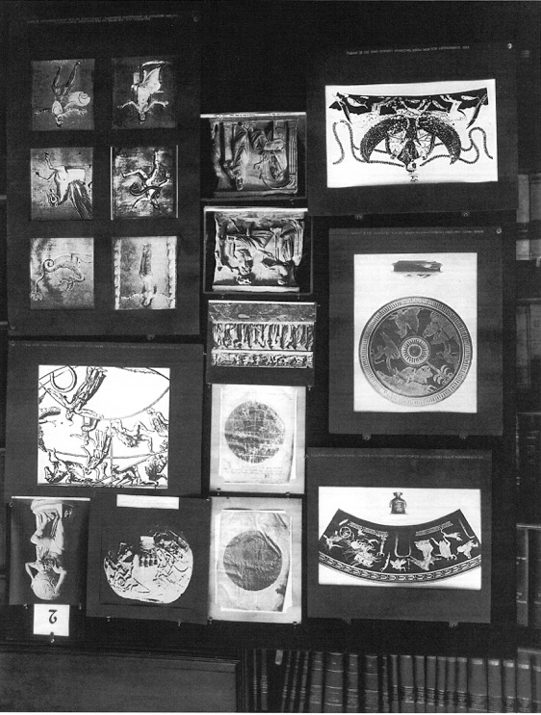
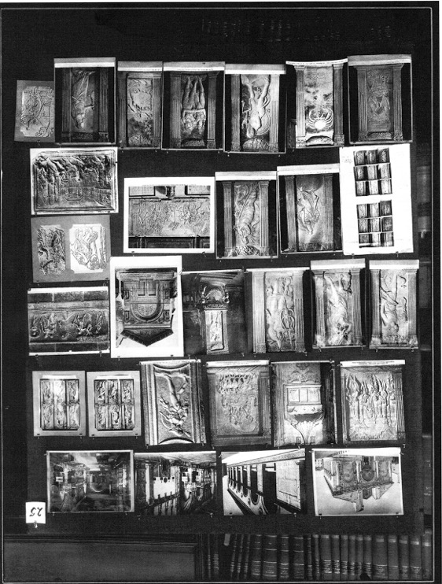
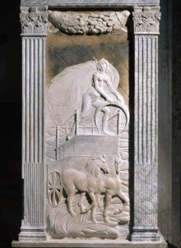
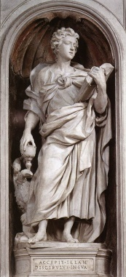
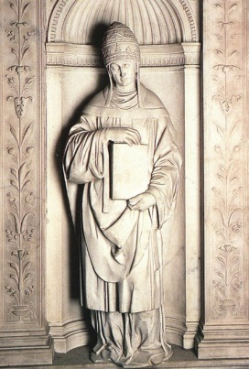
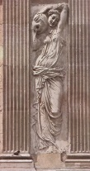
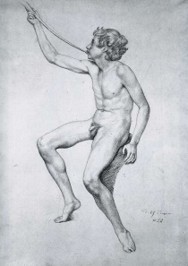
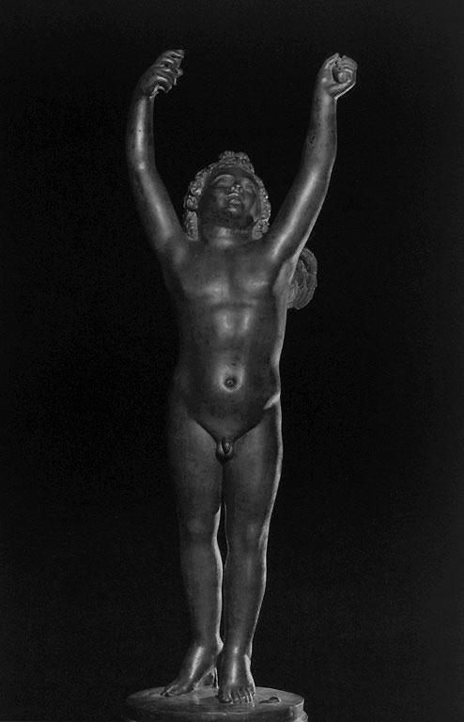
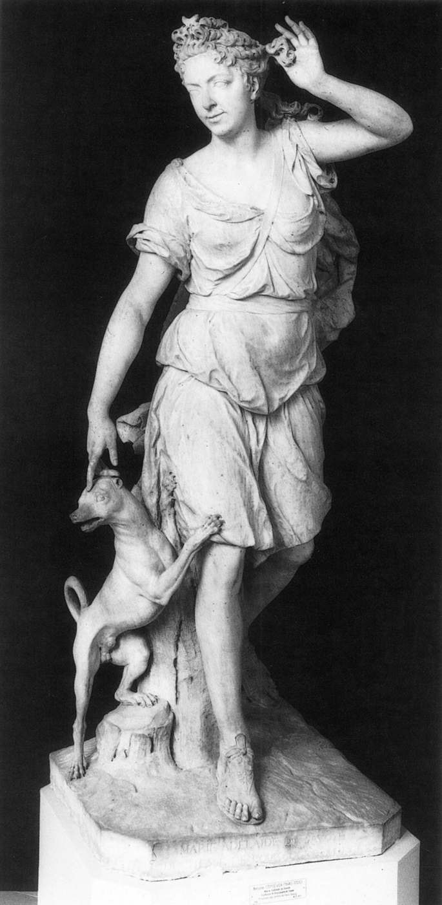
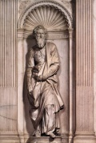
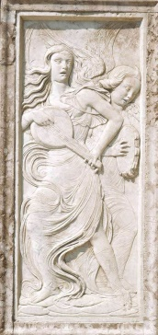
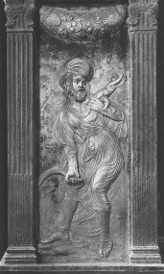
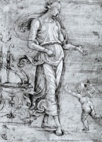
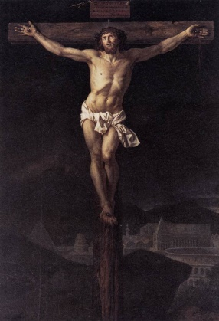
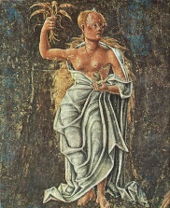
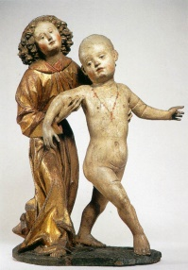
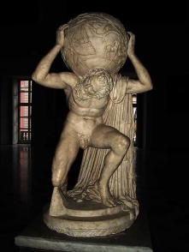
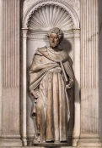
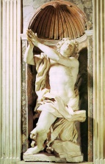
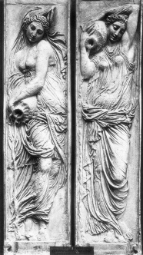
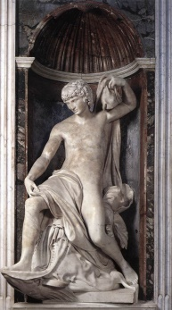
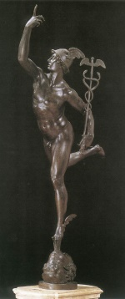
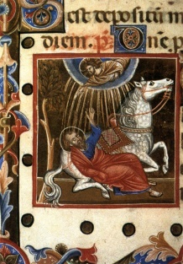
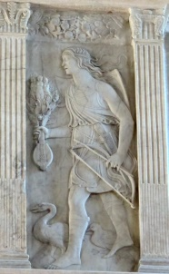
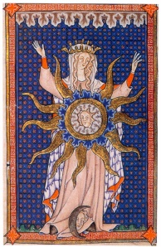
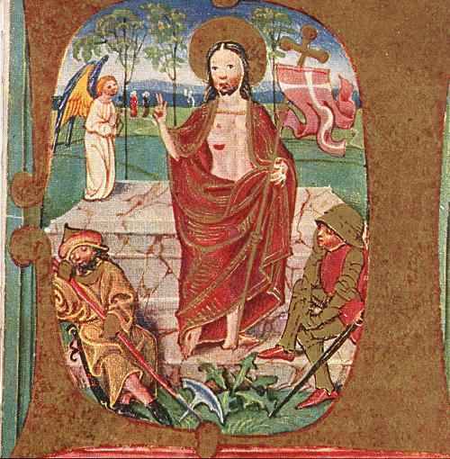
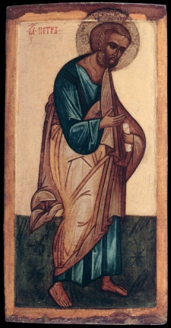
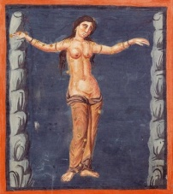
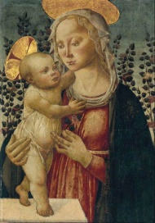
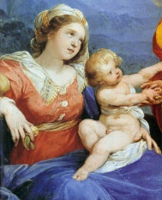
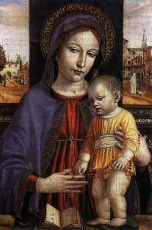
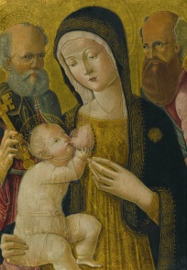

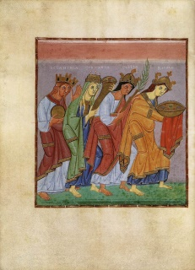
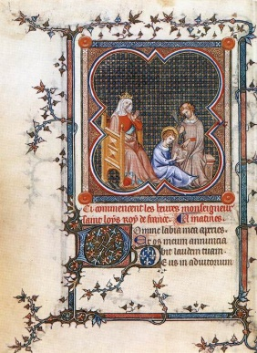
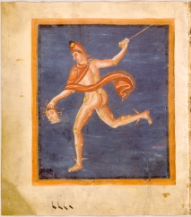
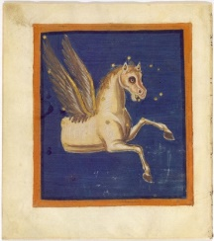
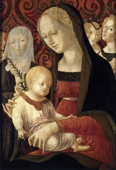
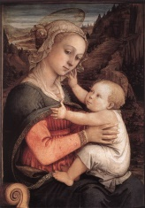
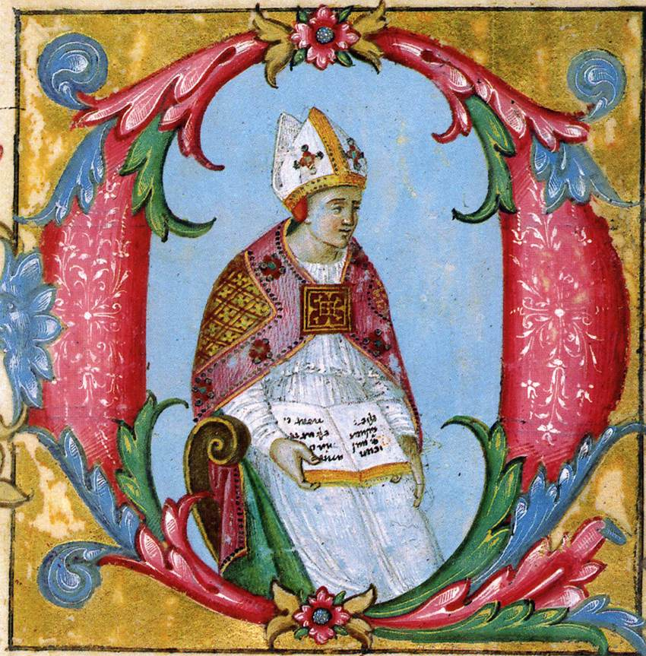
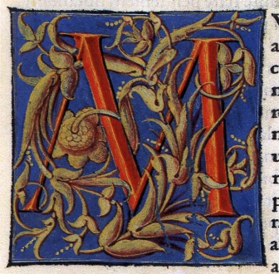
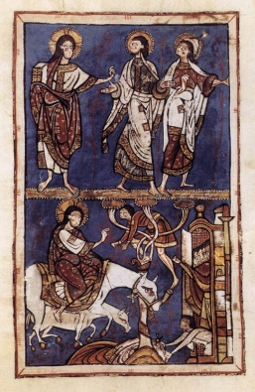
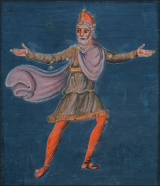
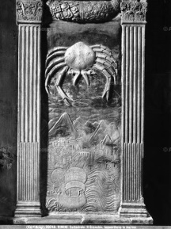
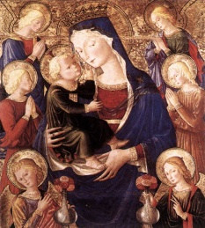
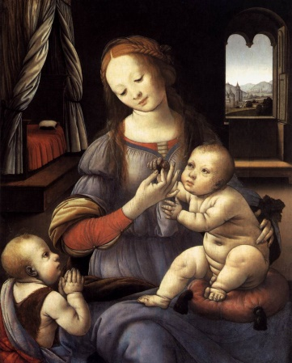
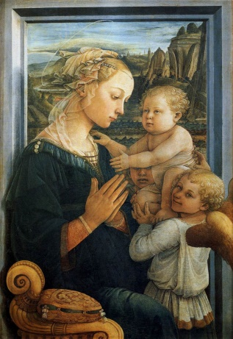

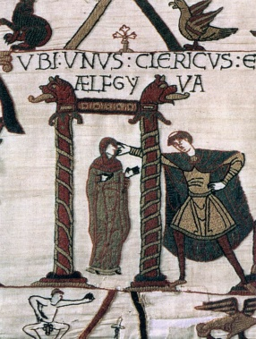
































































































Bilderatlas
What could have Warburg done using modern tools?
Bugliarello E., Caputo E., Giunto A.
Supervised by: di Lenardo I., Kaplan F., Seguin B.
Project Description
Bilderatlas is a collection of tables, created by the German art historian Aby Warburg. Each table consists of several pictures (paintings, architecture, statues) sharing a common theme. Warburg’s work, however, remained incomplete. Despite his vast knowledge, the amount of artworks he considered is very small compared to today’s available databases of images. The aim of our project is to explore the question:
What could have Warburg done using modern tools?
Methods
In some tables there is no apparent visual connection between images. As a consequence, rather than using a computational method based on visual features, we need to base our research on a high-level representation of the images. This means that the pictures must not be read just as collection of pixels, but rather in a more informative way. We thus perform our analyses using a particular deep learning technique, the Convolutional Neural Networks (CNN): this algorithm takes as input an image and extracts a feature array that characterizes it. To launch the queries we use DH Replica, a server developed at the DH Lab that allows to perform CNN analysis on a database of more than 40,000 images (still a small database compared to today’s possibilities).
Tab. 2: Greece as home of anthropomorphic representation of the cosmos, with mythological figures crowding the sky.
Tab. 25: The harmonic structure of the Apollonian cosmos and the Dionysiac dynamism of the goddesses.
Tab. 45: Lethal threats (e.g., tyranny, war) against the possibility of achieving psychological “balance”.
Tab. 46: Series of variations on Ghirlandaio's fruit-bearing “nymph”, reported in paintings, drawings and photos.
Results
References:
Warburg A., L'Atlas Mnémosyne
warburg.library.cornell.edu
engramma.it
replica.dhlabdemo.org:5089
github.com/e-bug/bilderatlas
Even without the possibility of setting images to negative, the queries provided interesting results. The developed algorithm is able to recognize efficiently visual similarities. In tab. 25 the queries returned images of statues, especially when enclosed into a frame (often represented by columns). Also the medallion research in tab. 46 proved to be successful: mainly medallions of the same style were reported (indeed, from artists that operated in the same epoch), with a human figure in the center, surrounded by text. Surprising results were attained when querying the arc in tab. 46: images with a predominant arc architecture were reported, including arcs in perspective! Tab. 45 had the most astonishing outcome. The two central paintings depict the opposite themes of the table: calmness vs agitation. They both have an architectural feature standing out in the background, but while one scene in the foreground is calm, in the other painting we find a battle. Incredibly, the algorithm is able to discern the two conditions, reporting static scenes in one case, and dynamic scenes in the other! Lastly, the query of the nymph in tab. 46 yielded interesting results. A few nymph-like figures were found, despite the different styles. A substantial difference was found when launching the single nymph, or the nymph in the crowd. To conclude, the strengths of this algorithm originate from the extraction of a low-level characterization of the images. The possibility of constructing a common feature by launching more images at the same time allows the user to guide the algorithm towards the desired pattern. With the help of “negative” images, this algorithm can become even more powerful.

